Slide 1

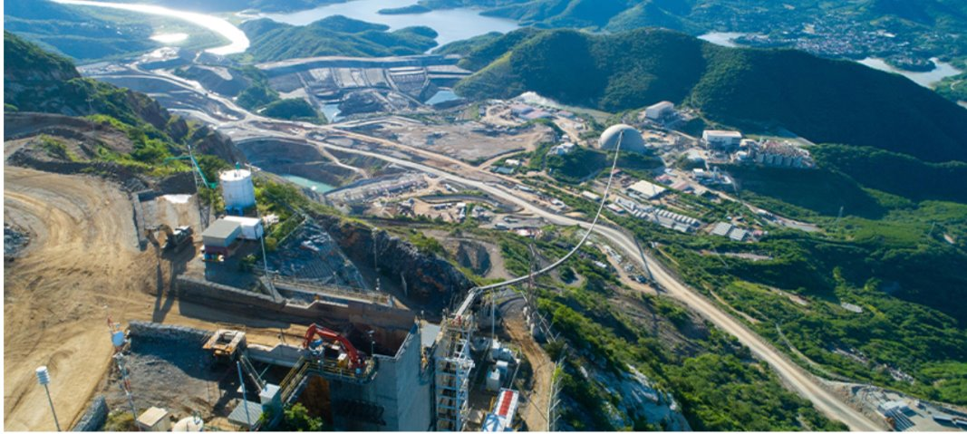
Torex – DWH – Implementation

Slide 2
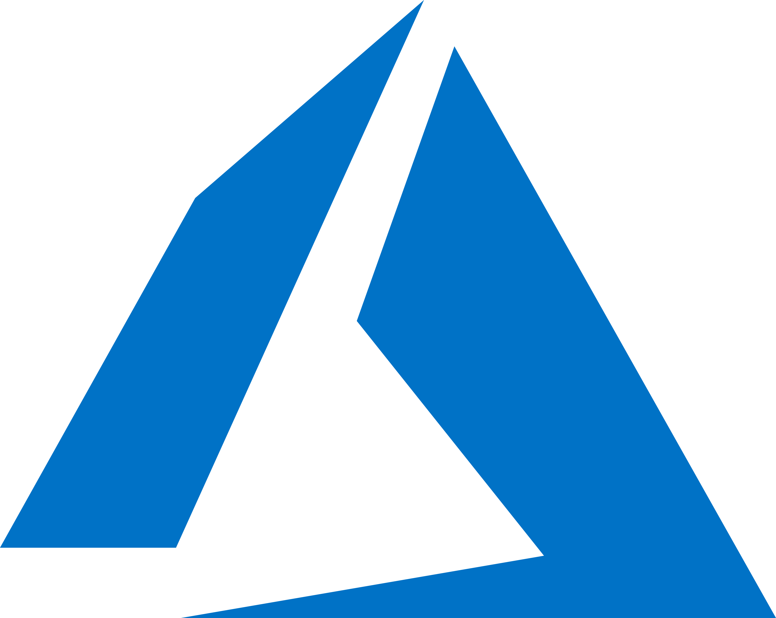

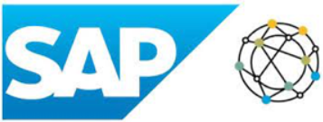






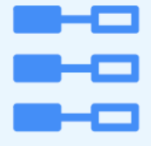







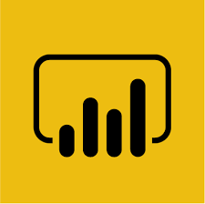




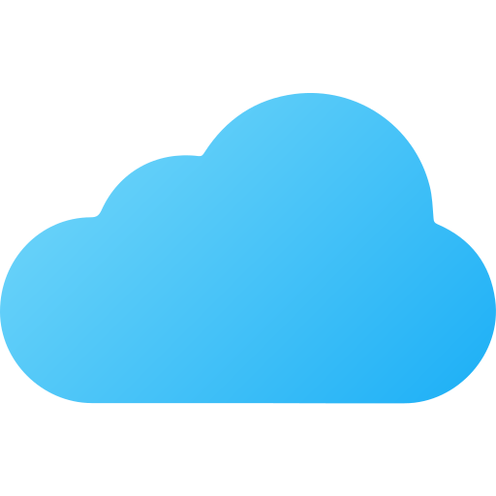









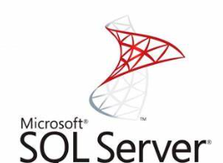




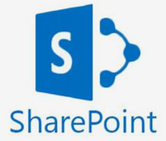

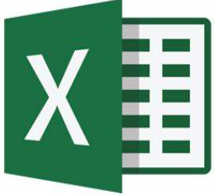




Torex – DWH – Target State Architecture using MS Fabric Lakehouse
0
Microsoft Fabric Unified SAAS Data Analytic Platform
SAP
Sources
SAP Datasphere
8
Orchestration
Data Factory
Ingestion Layer
Data Layer
Serving Layer
Consumption Layer
1
Replication
Flow
Data Replication
Full Load
Delta Load
Filter, Cleaned, Processed
Business-level Aggregates
6
Consumers
Raw Ingestion /History
Cloud
Connector
ABAP CDS
Views
7
PUSH
Shortcut
Data
Analyst
Data Pipeline
SQL Analytics Endpoint
ADLS Gen2
Bronze
Silver
Gold
Improve Data Quality
Semantic Model
Power BI
Self-Service
Analyst
ODATA API
PULL
4
One Lake
3
2
Processing Layer
Non-SAP
Sources
5
Apps
Report
Consumers
On-Premises
Data Gateway
Dataflow Gen2
Spark jobs
Spark
notebooks
Platform Management, Governance, Security & Compliance
Microsoft Purview Hub
(Optional)
Data Activator
(Optional)
Fabric Admin Portal
Web API
Azure
Key-Vault
Azure cost
management
Fabric Capacity Pause/Resume
Entra ID
Azure Devops
Azure Portal
9
0
Set-up SAP BTP Platform , Configure Sap Datasphere
3
Ingest the data from SAP SF & Non-SAP sources into the Bronze layer
7
Connect Power BI to consume the data via SQL Analytics Endpoint/Asemantic Model/Apps
1
Establish the connectivity between SAP S4 and Azure using Cloud connector. Set-up the Replication flows to extract the S4 CDS Views (Initial & Delta) into the Azure Landing (ADLS Gen2)
4
Improve the Quality of Data(source data,/Transform/ Aggregate)
8
Pipeline Orchestration
5
Process the data using SQL/Spark Engine and load into Gold Layer
9
Enable Platform Activities
2
Establish the connectivity between SAP SF & Non-SAP Sources
6
Enable the SQL pool end point/semantic model/apps for consumption

Slide 3
Key Architectural Considerations/Decisions
Sno | Source | Consideration
1 | SAP S4 HANA | For SAP S4 HANA, Implemented SAP Data Sphere pass-through medium to Azure. At that time, there was no direct integration with OneLake using SAP Data Sphere, so we established a landing zone called ADLSGEN2 within Azure. Once the OneLake connector becomes available for SAP Data Sphere, we can reconsider this setup.
2 | SAP SF | As SAP SF is exposed via APIs, we have opted for ODATA API-based extraction to retrieve data from the source.
3 | SharePoint (Excell) | During the MS Fabric setup, we discovered that MS ADF does not support connecting to SharePoint folders using the REST API. Therefore, we opted for the Data Flow Gen2 path with the Web API connector[provided access to individual Excel file], due to performance issues with the SharePoint site URL. Raised tickets with Microsoft but received no formal resolution, so we implemented an alternative method. Once MS Fabric ADF supports connecting to SharePoint folders via REST API, we can reconsider the solution.
4 | On-Prem SQL Server | Leverage the WFS Gateway On-Premises Data Gateway to connect and extract data from the on-premises SQL Server.
5 |  | Although the architecture includes the MS Fabric Purview Hub and Data Activator, we have not implemented these in the current scope.

Slide 4
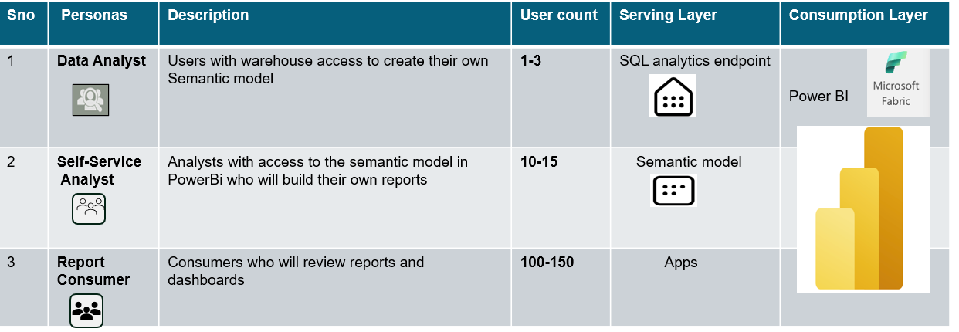
MS Fabric User Persona Requirements

Slide 5















Torex MS Fabric Deployment Pattern
txg-dwh-ws-dev
Bronze Lakehouse
Silver
Lakehouse
Gold
Warehouse
txg-dwh-ws-prd
Bronze Lakehouse
Silver
Lakehouse
Gold
Warehouse
Txgdwhfabricdev
F8 SKU
mml-da-ws-prd
Operations
Maintenance
Supply chain
Finance
bi-app-prd
txg-da-ws-prd
Finance
Supply chain
Txg-hr-da-ws-prd
HR

Slide 6
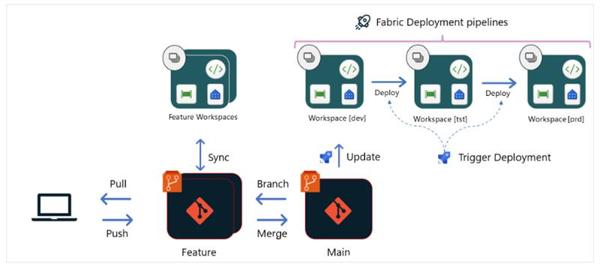
Devops Process

Slide 7
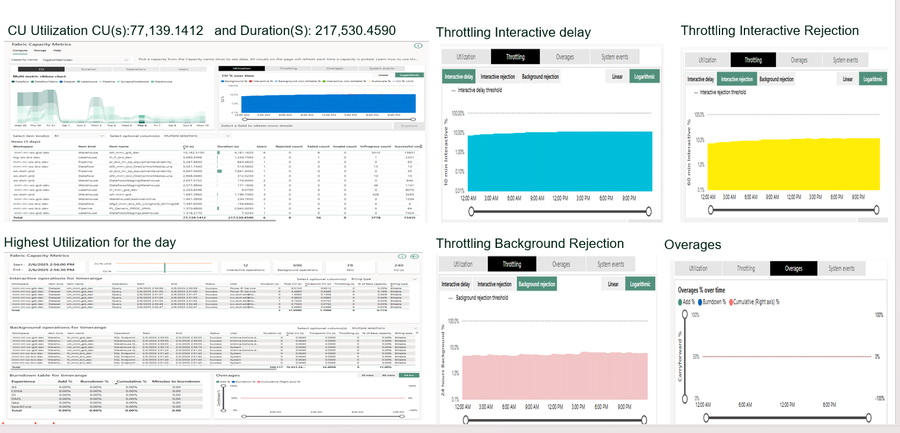
MS Fabric Capacity Metrics App Monitoring

